Slide 1
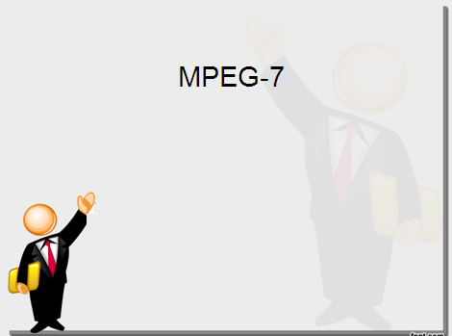

Image Enhancement using Zero Memory Point Operations
Kiran TALELE
 99 870 30 881

Slide 2
Kiran TALELE
@ Bharatiya Vidya Bhavans’ Sardar Patel Institute of Technology Andheri(w) Mumbai
Associate Professor, Electronics Engineering Department (1997)
Dean, Students, Alumni & External Relations (2022)
@ Sardar Patel Technology Business Incubator(SP-TBI),
Funded by Department of Science & Technology(DST),
Govt. of India
Head, Academic Relations (2015)
@ IEEE Bombay Section
Treasurer (2020)
Executive Committee Member (2015)
Kiran TALELE
2

Slide 3
Objective :
Image Enhancement
To process a given image so that the result is more suitable than the original image for a specific application.
IMP : The enhancement process does not increase the inherent information content in the data.
But it does increase the dynamic range of the chosen feature so that they con be detected easily.
3
Kiran TALELE 99870 30 881 talelesir@gmail.com

Slide 4
[1] Image Enhancement using Zero Memory Point Operations
Let r denotes input image pixel value
and s denotes output image pixel value
Then S = T (r)
where T is any Spatial Domain Tx function.
4
Kiran TALELE 99870 30 881 talelesir@gmail.com

Slide 5
Basic Gray Level Transformations using Zero Memory Point Operations
Contrast Stretching Transformations
Clipping and Thresholding
Digital Negative
LOG Transformation
Power Law Transformation
Intensity Level Slicing
Bit Level slicing
5
Kiran TALELE 99870 30 881 talelesir@gmail.com

Slide 6
[1] Contrast Stretching Transformaton
(i) Low Contrast Image occur often due to
Poor or Non-uniform Lighting conditions
Limited dynamic range of imaging sensor
Improper setting of lens aperature.
6
Kiran TALELE 99870 30 881 talelesir@gmail.com

Slide 7
A Contrast Stretching Transformation function can be achieved by
s
Stretching Dark range of input values into wider range of output values.
(L-1)
S₂
S₁
0
Shifting Mid range of input values
r
Compressing Bright range of input values.
0 a b (L-1)
Dark range
Mid range
Bright range
7

Slide 8
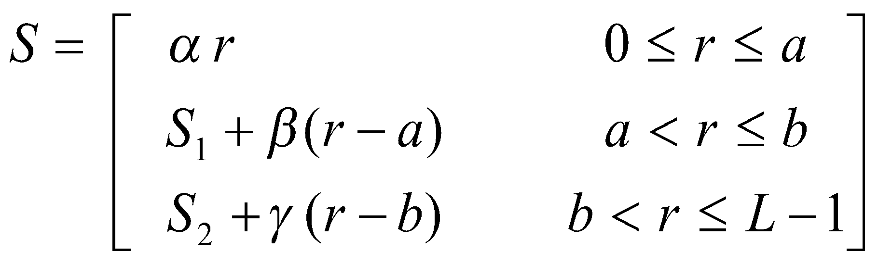
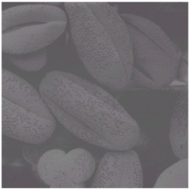
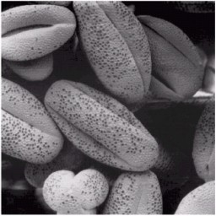
(iii) Mathematically,
It is defined as S= T(r)
where T is Contrast Stretching Tx function such that,
S
(L-1)
S₂
S₁
0
r
0 a b (L-1)
Input Image
Output Image

Slide 9
Ex. Obtain the gray level transformation function that :
Stretches gray scale range [0, 10] into [0, 15]
Shifts the range [10,20] to [15,25] and
Compresses the range [20,30] into [25,30].
9
Kiran TALELE 99870 30 881 talelesir@gmail.com

Slide 10
ANS : Gray level transformation function that :
Stretches gray scale range
[0, 10] into [0, 15]
s
(L-1)
S2
S1
0
30
γ
Shifts the range
[10,20] to [15,25] and
25
β
15
0
α
Compresses the range
[20,30] into [25,30].
r
0 10
20
30
0 a b (L-1)
α = 1.5 β = 1.0 γ = 0.5
10
Kiran TALELE 99870 30 881 talelesir@gmail.com

Slide 11
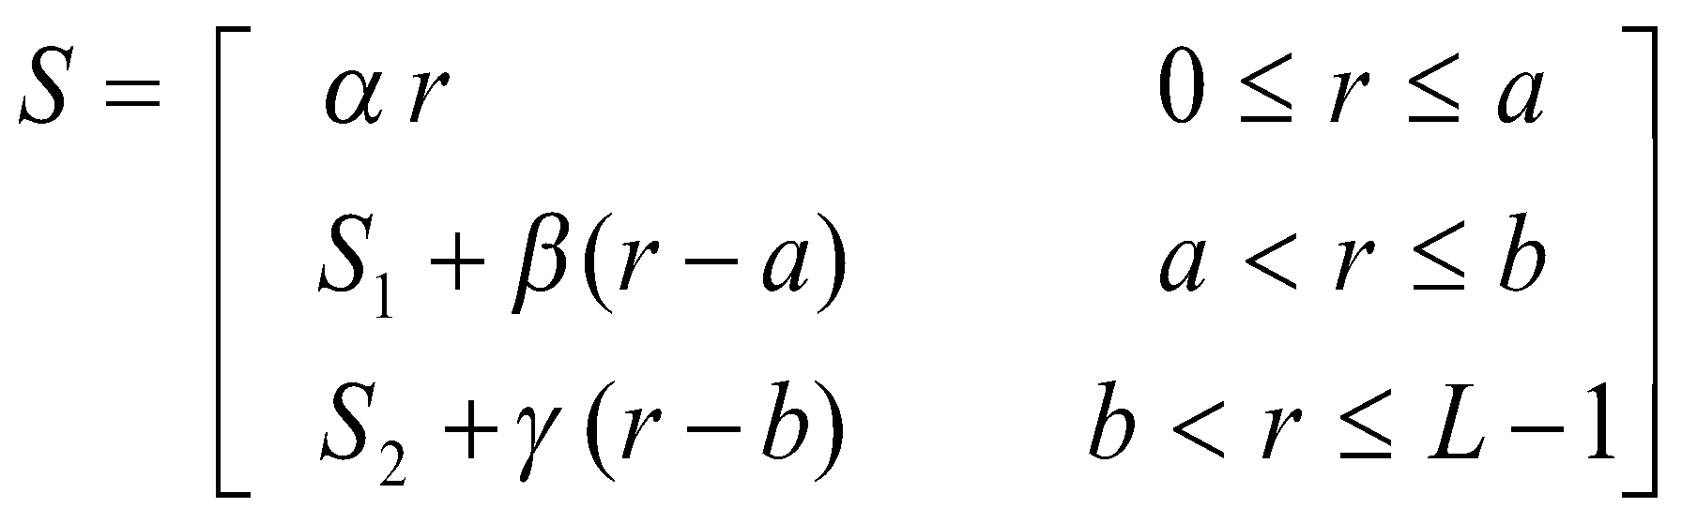
A Contrast Stretching Tx function is given by,
Where a = 10 b = 20
L-1 = 30
S1 = 15 S2 = 25
α = 1.5 β = 1.0 γ = 0.5
By substituting we get,
1.5 r
S = r + 5
S = 10 + (0.5) (r-b )
11
Kiran TALELE 99870 30 881 talelesir@gmail.com

Slide 12
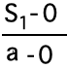
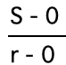
Q1. Derive Contrast Stretching
Transformation Function.
Case-1 : When 0<= r <= a
s
To find Slope
α =
(L-1)
S₂
S₁
0
(ii) To find Slope
α =
(r,s)
r
S = α r - - - - - (I)
0 a b (L-1)

Slide 13
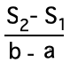
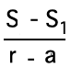
Case-2 : When a < r < = b
s
To find Slope
β =
(L-1)
S₂
S₁
0
(b,s₂)
(ii) To find Slope
β =
(r,s)
(a,s₁)
r
S - S₁ = β (r-a)
0 a b (L-1)
S = S₁ + β (r-a) - - - -(II)
13
Kiran TALELE 99870 30 881 talelesir@gmail.com

Slide 14
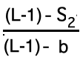
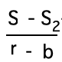
Case-3 : When b < r < =(L-1)
s
To find Slope
ϒ =
(L-1)
S₂
S₁
0
(L-1, L-1)
(r,s)
(b,s₂)
(ii) To find Slope
ϒ =
r
S - S₂ = ϒ (r-b)
0 a b (L-1)
S = S₂ + ϒ (r-b) - - - (III)
14
Kiran TALELE 99870 30 881 talelesir@gmail.com

Slide 15
From equation (I), (II) and (III) we get,
α r
S = S₁ + β (r-a)
s
S = S₂ + ϒ (r-b )
(L-1)
S2
S1
0
γ
β
α
r
0 a b (L-1)
15
Kiran TALELE 99870 30 881 talelesir@gmail.com

Slide 16
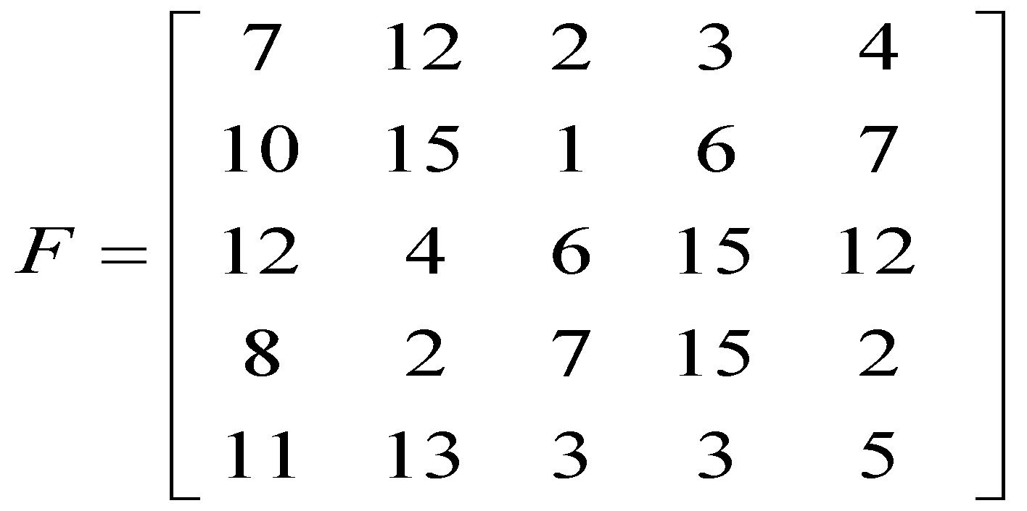
Q2. Apply following Transformation function on the image F and obtain new image.
S
15
12
8
0
r
0 4 8 15
16
Kiran TALELE 99870 30 881 talelesir@gmail.com

Slide 17
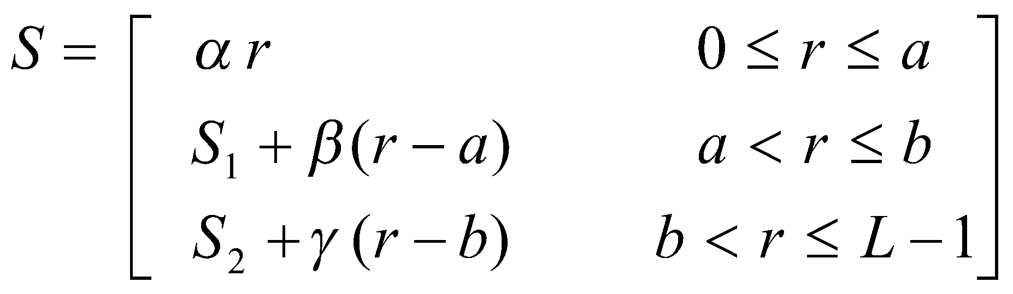
A Contrast Stretching Tx function is given by,
S
15
12
8
0
γ
Where
a = 4 b = 8
L-1 = 30
S1 = 8 S2 = 12
α = 2 β = 1 γ = 3/7
β
α
r
0 4 8 15
17
Kiran TALELE 99870 30 881 talelesir@gmail.com

Slide 18
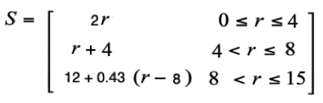
By substituting we get,
2 r
r + 4
12 + 0.43 (r – 8)
Output image A is then given by,
A =
11
18
Kiran TALELE 99870 30 881 talelesir@gmail.com

Slide 19
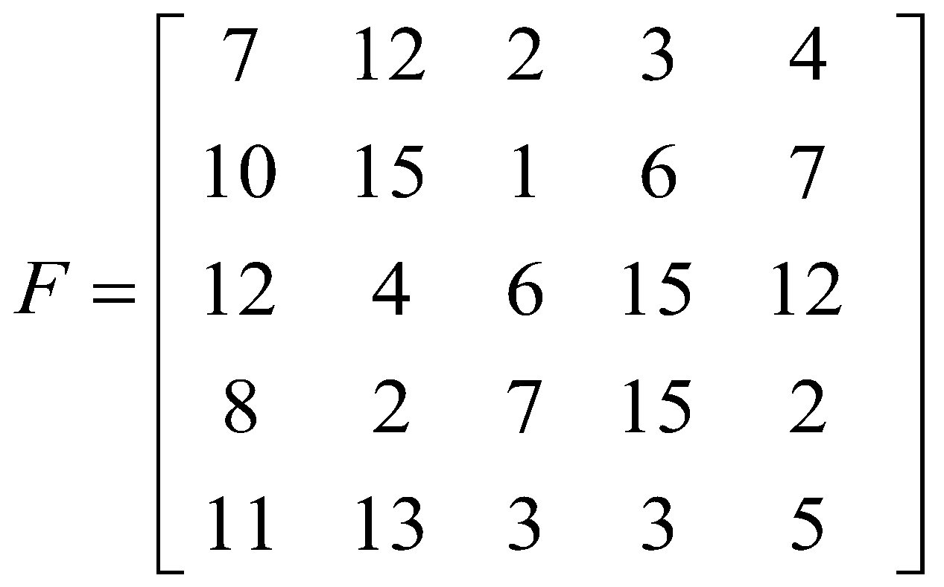
By substituting we get,
2 r
r + 4
12 + 0.43 (r – 8)
Output image A is then given by,
A =
11 | 14 | 4 | 6 | 8
19
Kiran TALELE 99870 30 881 talelesir@gmail.com

Slide 20
By substituting we get,
2 r
r + 4
12 + 0.43 (r – 8)
Output image A is then given by,
A =
11 | 14 | 4 | 6 | 8
13 | 15 | 2 | 10 | 11
14 | 8 | 12 | 15 | 14
12 | 1 | 4 | 15 | 4
13 | 14 | 6 | 6 | 9
20
Kiran TALELE 99870 30 881 talelesir@gmail.com

Slide 21
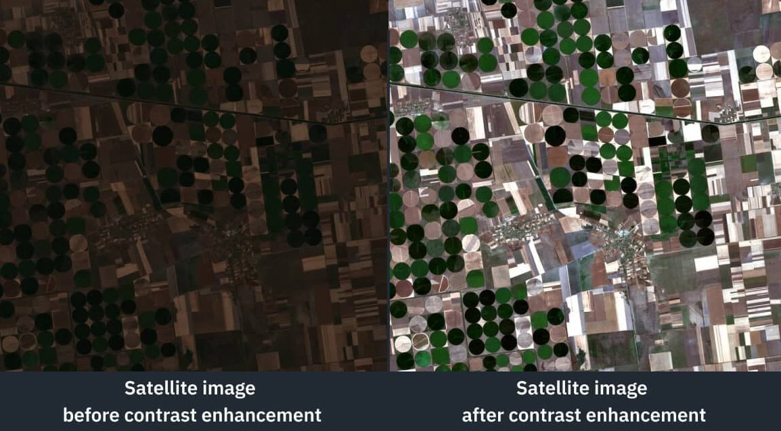
A =
21
Kiran TALELE 99870 30 881 talelesir@gmail.com

Slide 22
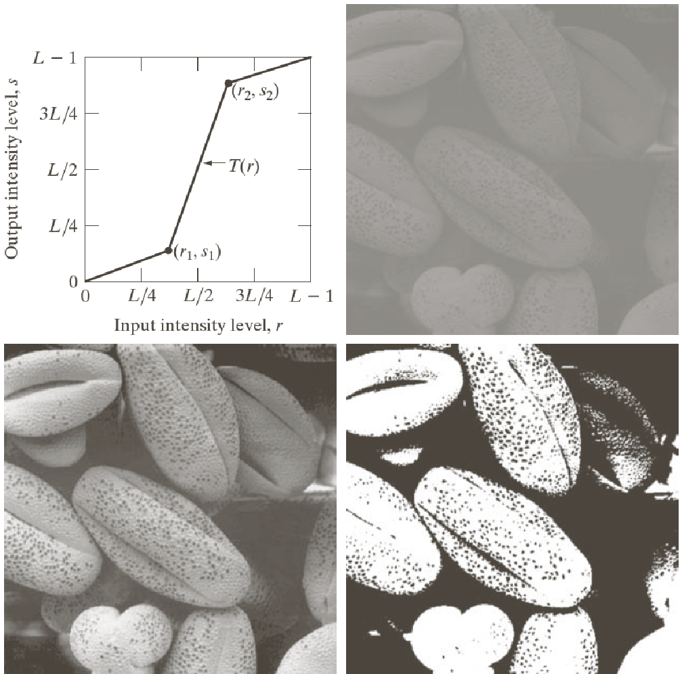
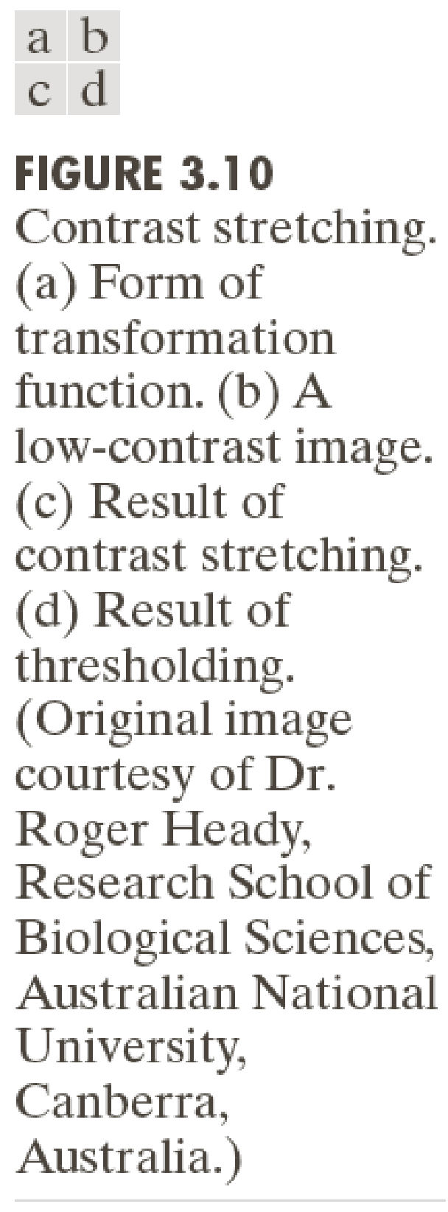
22
Kiran TALELE 99870 30 881 talelesir@gmail.com

Slide 23
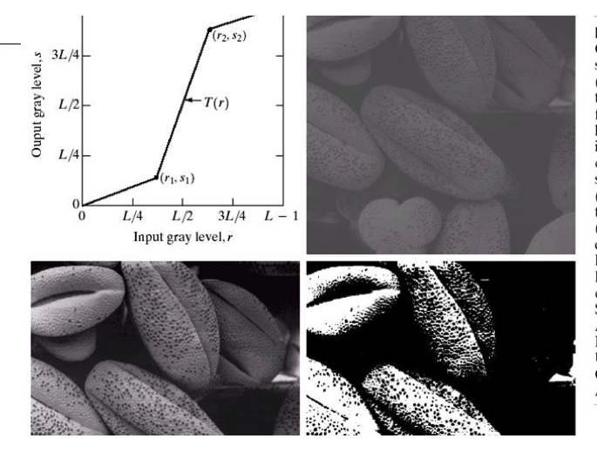

Slide 24
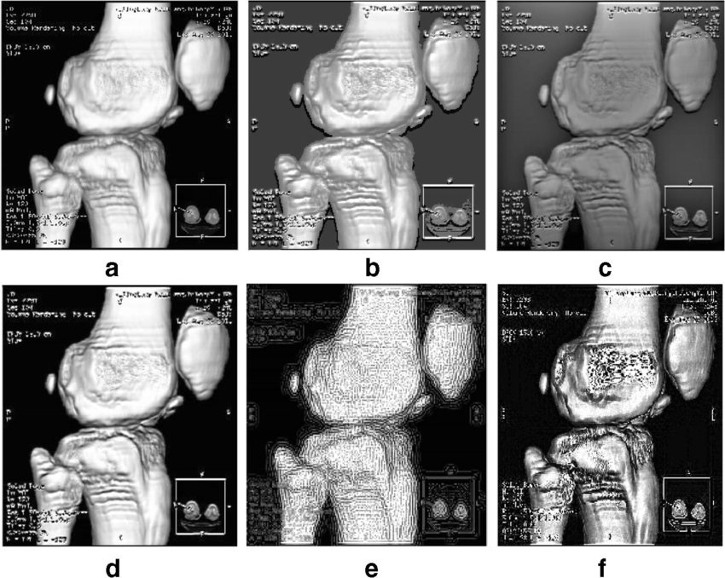

Slide 25
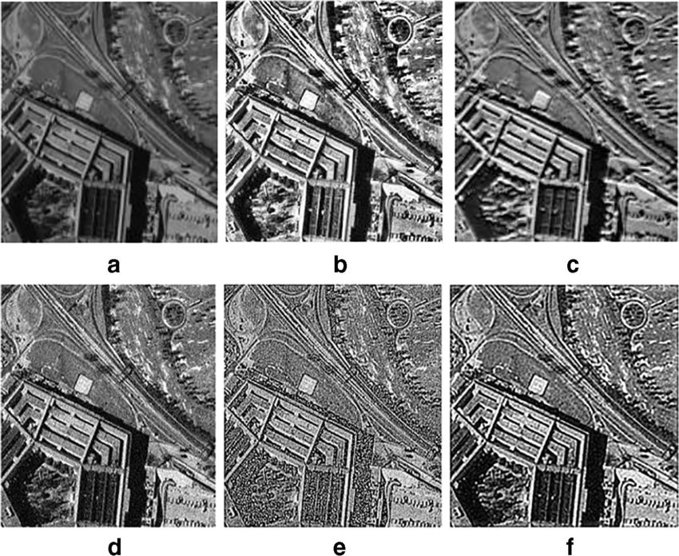

Slide 26
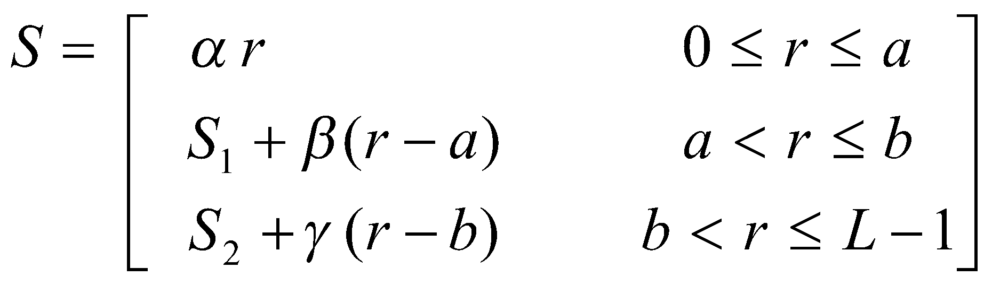
[2] Clipping and Thresholding
It is a special case of Contrast Stretching
Tx function.
(ii) A Contrast Stretching Tx function is given by,
26
Kiran TALELE 99870 30 881 talelesir@gmail.com

Slide 27
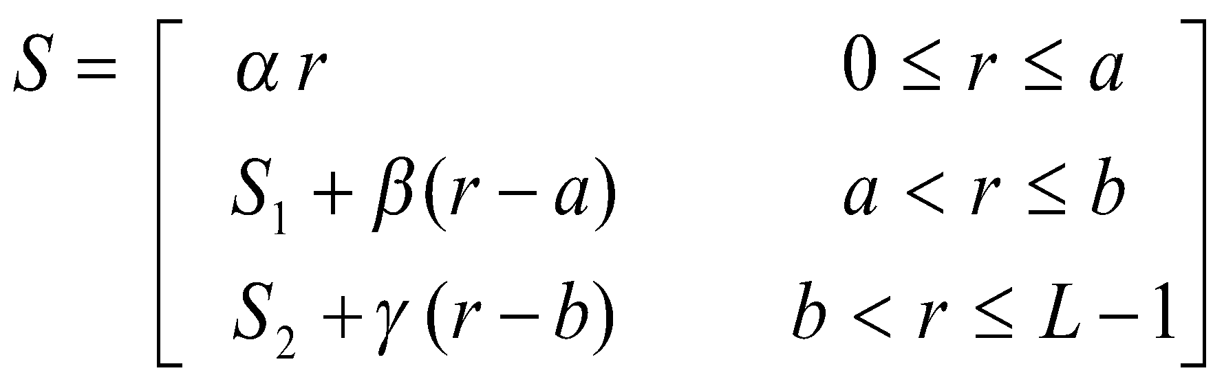
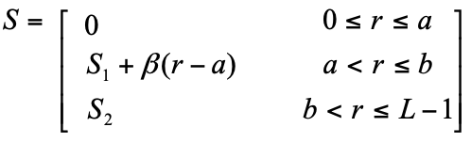
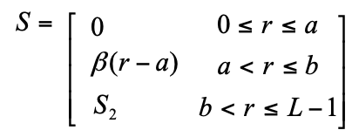
Clipping . . .
Case-1 : When α = 0 and γ = 0
S
(L-1)
S₂
S₁
0
r
0 a b (L-1)
Case-2 : When α = 0, γ = 0 and S₁= 0
S
(L-1)
S₂
S₁=0
r
0 = a b (L-1)

Slide 28
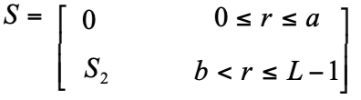
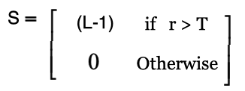
Thresholding . . .
Case-3 : When α = 0, γ = 0, S₁= 0 and a == b
S
S₂
0
r
0 a=b (L-1)
Thresholding Simplifies
S
(L-1)
r
0 T (L-1)
Kiran TALELE 99870 30 881 talelesir@gmail.com

Slide 29
Q4 Given Image F and Transformation Function. (a) Obtain the new image. (b) Plot Histogram of input & output Image (c) Compare the histograms of I/O image.
S
F =
2 | 3 | 4 | 2
5 | 5 | 2 | 4
3 | 6 | 3 | 5
5 | 3 | 5 | 5
8
0,0
2
6
r
29
Kiran TALELE 99870 30 881 talelesir@gmail.com

Slide 30
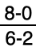
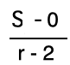
(a) Obtain the new image Solution : To obtain New Image
S
Case-1 : When 0<= r <= 2
(6,8)
S = 0 ----(I)
8
Case-2 : When 2< r <= 6
(r,s)
To find Slope
β =
0,0
(2,0)
r
= 2
(ii) To find Slope
β =
= 2
S = 2 ( r - 2 ) - - - -(II)

Slide 31
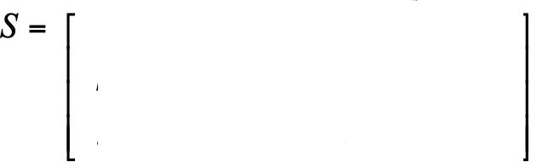
S
Case-3 : When r > 6
8
S = 8 ----(III)
0,0
2
6
r
From equation (I), (II) and (III) we get,
0
0<= r <= 2
2< r <= 6
S = 2 ( r - 2 )
S = 8
r > 6
31
Kiran TALELE 99870 30 881 talelesir@gmail.com

Slide 32
0
0<= r <= 2
2< r <= 6
S = 2 ( r - 2 )
S = 8
r > 6
Output image A is then given by, A = T{ r}
F =
2 | 3 | 4 | 2
5 | 5 | 2 | 4
3 | 6 | 3 | 5
5 | 3 | 5 | 5
A =
0 |  |  | 0
 |  | 0
32
Kiran TALELE 99870 30 881 talelesir@gmail.com

Slide 33
0
0<= r <= 2
2< r <= 6
S = 2 ( r - 2 )
S = 8
r > 6
Output image A is then given by, A = T{ r}
F =
2 | 3 | 4 | 2
5 | 5 | 2 | 4
3 | 6 | 3 | 5
5 | 3 | 5 | 5
A =
0 | 2 | 4 | 0
6 | 6 | 0 | 4
2 |  | 2 | 6
6 | 2 | 6 | 6
33
Kiran TALELE 99870 30 881 talelesir@gmail.com

Slide 34
0
0<= r <= 2
2< r <= 6
S = 2 ( r - 2 )
S = 8
r > 6
Output image A is then given by, A = T{ r}
F =
2 | 3 | 4 | 2
5 | 5 | 2 | 4
3 | 6 | 3 | 5
5 | 3 | 5 | 5
A =
0 | 2 | 4 | 0
6 | 6 | 0 | 4
2 | 6 | 2 | 6
6 | 2 | 6 | 6
34
Kiran TALELE 99870 30 881 talelesir@gmail.com

Slide 35
(b) To plot Histogram
Input Image :
Ouput Image :
F =
2 | 3 | 4 | 2
5 | 5 | 2 | 4
3 | 6 | 3 | 5
5 | 3 | 5 | 5
A =
0 | 2 | 4 | 0
6 | 6 | 0 | 4
2 | 8 | 2 | 6
6 | 2 | 6 | 6
35
Kiran TALELE 99870 30 881 talelesir@gmail.com

Slide 36
0 | 2 | 4 | 0
6 | 6 | 0 | 4
2 | 8 | 2 | 6
6 | 2 | 6 | 6
Input Image :
Frequency Table of input image :
F =
2 | 3 | 4 | 2
5 | 5 | 2 | 4
3 | 6 | 3 | 5
5 | 3 | 5 | 5
Gray Value | Frequency
0 | 0
1 | 0
2 | 3
3 | 4
4 | 2
5 | 6
6 | 1
7 | 0
8 | 0
Histogram of Input Image :
Freq
6
4
3
2
1
0 1 2 3 4 5 6 7 8 r
36

Slide 37
0 | 2 | 4 | 0
6 | 6 | 0 | 4
2 | 8 | 2 | 6
6 | 2 | 6 | 6
Output Image :
Frequency Table of Output image :
A =
0 | 2 | 4 | 0
6 | 6 | 0 | 4
2 | 8 | 2 | 6
6 | 2 | 6 | 6
Gray Value | Frequency
0 | 3
1 | 0
2 | 4
3 | 0
4 | 2
5 | 0
6 | 6
7 | 0
8 | 1
Histogram of Output Image :
Freq
6
4
3
2
1
0 1 2 3 4 5 6 7 8 S
37

Slide 38
(c) Compare of Input and Output image Histogram
Input Image has limited pixel range [2-6].
So, input image has LOW contrast.
Input Image pixel range [2-6] is increased to
[0-8] in the output image.
Thus, Contrast of output image is improved.
3. Distribution of pixels is NOT uniform in both input and output image,
38
Kiran TALELE 99870 30 881 talelesir@gmail.com

Slide 39
Histogram of Input Image :
Input Image has limited pixel range [2-6].
Thus, input image has LOW Contrast
Freq
6
4
3
2
1
r
0 1 2 3 4 5 6 7 8
Input Image pixel range [2-6] is increased to
[0-8] in the output image.
Thus, Contrast of output image is improved.
Histogram of Output Image :
Freq
6
4
3
2
1
S
0 1 2 3 4 5 6 7 8

Slide 40
Histogram of Input Image :
3. Distribution of pixels is NOT uniform in both input and output image
Freq
6
4
3
2
1
r
0 1 2 3 4 5 6 7 8
Histogram of Output Image :
Freq
6
4
3
2
1
S
0 1 2 3 4 5 6 7 8

Slide 41
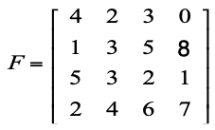
Ex. Given Threshold T = 4
Solution :
Max Pixel Value = 8
So, L = 2⁴ == 16
Ouput Image :
By Thresholding Tx,
A =
0 | 0 | 0 | 0
0 | 0 | 15 | 15
15 | 0 | 0 | 0
0 | 0 | 15 | 15
If r > (T = 4)
Then
S = 15 (Max = L-1)
Else
S = 0
Kiran TALELE 99870 30 881 talelesir@gmail.com

Slide 42
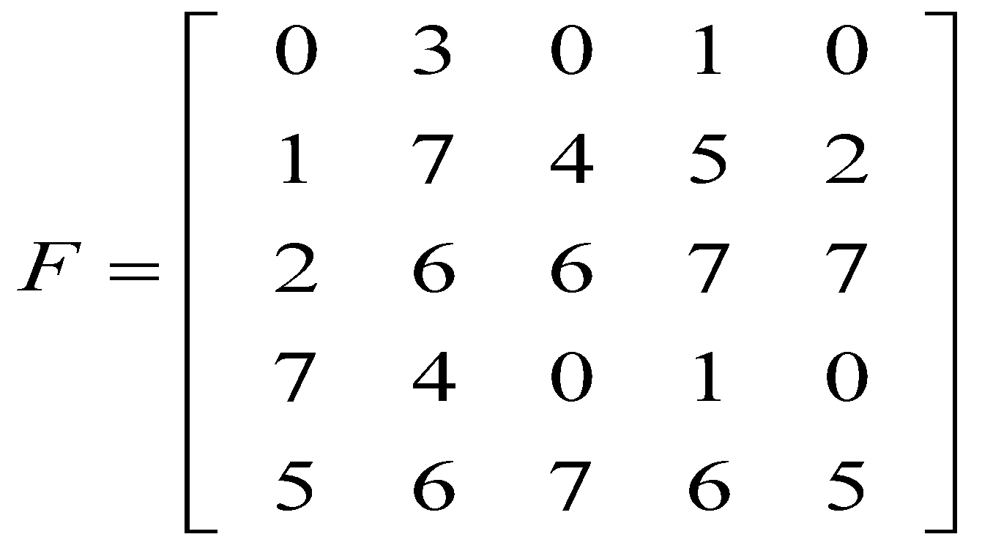
Q5 Convert the gray image to Binary Image.
Select appropriate value of threshold from
the histogram.
42
Kiran TALELE 99870 30 881 talelesir@gmail.com

Slide 43
Solution : To plot Histogram of Input Image :
Frequency Table of image F:
Gry Value | Frequency
0
1
2
3
4
5
6
7
43
43
Kiran TALELE 99870 30 881 talelesir@gmail.com
Kiran TALELE 99870 30 881 talelesir@gmail.com

Slide 44
Solution : To plot Histogram of Input Image :
Frequency Table of image F:
Gray Value | Frequency
0 | 5
1 | 3
2 | 2
3 | 1
4 | 2
5 | 3
6 | 4
7 | 5
44
44
Kiran TALELE 99870 30 881 talelesir@gmail.com
Kiran TALELE 99870 30 881 talelesir@gmail.com

Slide 45
Frequency Table of image F:
Gray Value | Frequency
0 | 5
1 | 3
2 | 2
3 | 1
4 | 2
5 | 3
6 | 4
7 | 5
Histogram of Input Image :
Freq
5
5
4
3
3
2
2
1
1
r
0 1 2 3 4 5 6 7
45
45
Kiran TALELE 99870 30 881 talelesir@gmail.com
Kiran TALELE 99870 30 881 talelesir@gmail.com

Slide 46
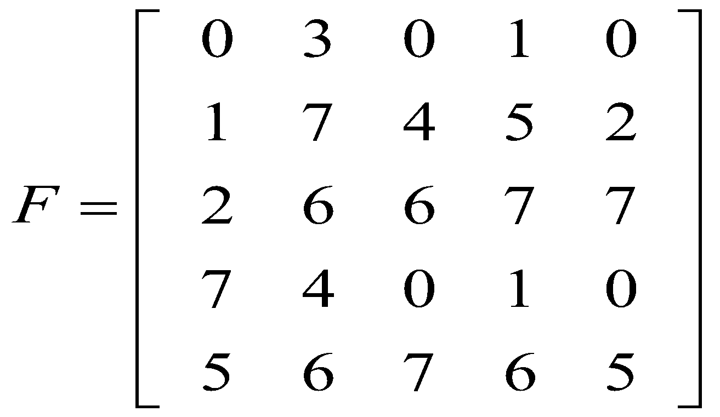
Let Threshold Value T = 3
If r > (T = 3)
Then
S = 7
Else
S = 0
Let S = T ( r )
Where r is the input image pixel value and S is the output image pixel value
Input Image :
Output Image :
A =
46
46
Kiran TALELE 99870 30 881 talelesir@gmail.com
Kiran TALELE 99870 30 881 talelesir@gmail.com

Slide 47
Let Threshold Value T = 3
If r > (T = 3)
Then
S = 7
Else
S = 0
Let S = T ( r )
Where r is the input image pixel value and S is the output image pixel value
Input Image :
Output Image :
A =
0 | 0 | 0 | 0 | 0
0 | 7 | 7 | 7 | 0
0 | 7 | 7 | 7 | 7
7 | 7 | 0 | 0 | 0
7 | 7 | 7 | 7 | 7
47
47
Kiran TALELE 99870 30 881 talelesir@gmail.com
Kiran TALELE 99870 30 881 talelesir@gmail.com

Slide 48
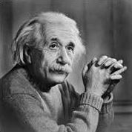
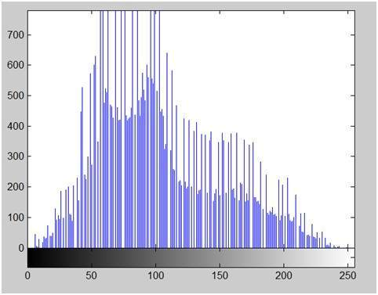
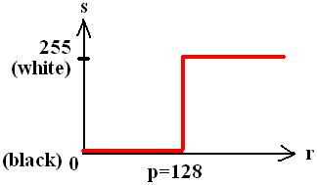
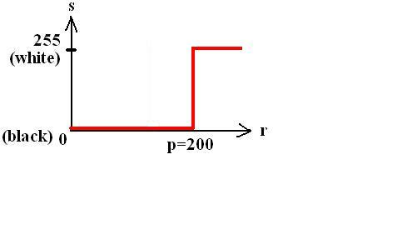
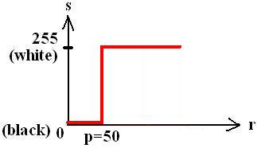
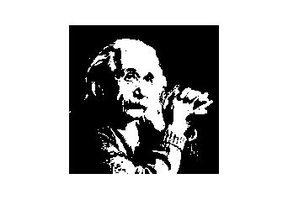
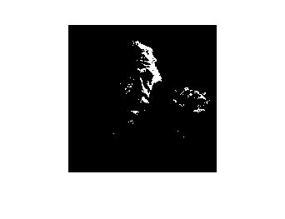
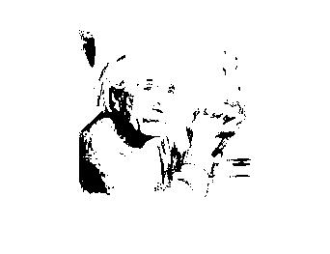
Example of Thresholding Transformation
Original
image
Histogram
T=128
T=50
T=200

Slide 49
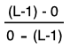
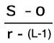
[3] Digital Negative
Negative Image is obtained by reverse scaling of gray levels of input image.
(i) Mathematically
(ii) Graphically
To find Slope
α =
s
= -1
(L-1)
To find Slope
α =
( r, s )
= -1
0
r
S = α[ r - (L-1) ]
0
(L-1)
S = (L-1) - r
49

Slide 50
Application :
[1] To obtain negative prints of Photograph
[2] To display Medical Images
50
Kiran TALELE 99870 30 881 talelesir@gmail.com

Slide 51
Ex. Given Obtain Negative Image
To find Output Image A:
Ouput Image :
By Digital Nagative Tx,
A =
11 | 13 | 12 | 15
14 | 12 | 10 | 7
10 | 12 | 13 | 14
13 | 11 | 9 | 8
S = (L-1) - r
Where L = 2⁴ == 16
S = 15 - r
Kiran TALELE 99870 30 881 talelesir@gmail.com

Slide 52
[4] LOG Transformation
(i) Mathematically,
S = C Log ( 1 + r )
Where,
r is input image pixel value
S is output image pixel value
And C is any Constant
Application :
To display Fourier Transformed Image
52
Kiran TALELE 99870 30 881 talelesir@gmail.com

Slide 53
(ii) Graphically,
LOG Tx, Enhances small magnitude input values into wider range of output values
s
(L-1)
0
r
(ii) LOG Tx, Compresses large magnitude input values into narrow range of output values
0
(L-1)
53
Kiran TALELE 99870 30 881 talelesir@gmail.com

Slide 54
Q6 Given Image F, Obtain the new image using LOG Transformation.
F =
128 | 212 | 25
54 | 0 | 124
4 | 152 | 15
54
Kiran TALELE 99870 30 881 talelesir@gmail.com

Slide 55
Sol : Let S = T(r)
Input Image
F =
128 | 212 | 25
54 | 0 | 124
4 | 152 | 15
S = C Log ( 1 + r )
Assume C =1
Then S = Log₁₀ ( 1 + r )
For F(0,0) =128 Find A(0,0)
Output Image
A(0,0) = Log₁₀ ( 1 + 128)
A =
2 | 2 | 1
2 | 0 | 2
1 | 2 | 1
A(0,0) = 2.11
Let A(0,0) == 2
55
Kiran TALELE 99870 30 881 talelesir@gmail.com

Slide 56
[5] Power Law Transformation
Mathematically,
s = r^{γ}
Where,
r is Normalized input image pixel value
S is Normalized output image pixel value
56
Kiran TALELE 99870 30 881 talelesir@gmail.com

Slide 57
S
When γ < 1
PLT maps narrow range of dark input values into wider range of ouput values
1
0
γ =0.5
r
0 1
S
(ii) When γ = 1
Output Pixel Value = Input Pixel Value
1
0
γ = 1
r
0 1
(iii) When γ > 1
PLT maps wider range of input values into narrow range of ouput dark pixel values
S
1
0
γ = 2
r
0 1

Slide 58
Q6. For the image given below perform the operation S = r²
A =
0 | 2 | 4 | 0
6 | 6 | 0 | 4
2 | 8 | 2 | 8
6 | 2 | 6 | 8
58
Kiran TALELE 99870 30 881 talelesir@gmail.com

Slide 59
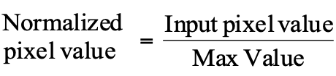
Step-1 : Find Normalized Input Pixel values
A =
0 | 2 | 4 | 0
6 | 6 | 0 | 4
2 | 8 | 2 | 8
6 | 2 | 6 | 8
Input Image
Max Value = 8
B =
0 | 0.25 | 0.5 | 0
0.75 | 0.75 | 0 | 0.5
0.25 | 1 | 0.25 | 1
0.75 | 0.25 | 0.75 | 1
59
Kiran TALELE 99870 30 881 talelesir@gmail.com

Slide 60
Step-1 : Find Normalized Input Pixel values
Step-2 : Apply Power
Law Transformation
S = r²
B =
C =
0 | 0.25 | 0.5 | 0
0.75 | 0.75 | 0 | 0.5
0.25 | 1 | 0.25 | 1
0.75 | 0.25 | 0.75 | 1
0 | 0.0625 | 0.25 | 0
0.5625 | 0.5625 | 0 | 0.25
0.0625 | 1 | 0.0625 | 1
0.5625 | 0.0625 | 0.5625 | 1
60
Kiran TALELE 99870 30 881 talelesir@gmail.com

Slide 61
Step-3 : Find De-normalized output Pixel values
De-normalized = Power Law Tx MAX Input value Output value Value
= (8)
0 | 0.0625 | 0.25 | 0
0.5625 | 0.5625 | 0 | 0.25
0.0625 | 1 | 0.0625 | 1
0.5625 | 0.0625 | 0.5625 | 1
=
0 | 0.5 | 2 | 0
4.5 | 4.5 | 0 | 2
0.5 | 8 | 0.5 | 8
4.5 | 0.5 | 4.5 | 8
=
0 | 1 | 2 | 0
5 | 5 | 0 | 2
1 | 8 | 1 | 8
5 | 1 | 5 | 8
61
Kiran TALELE 99870 30 881 talelesir@gmail.com

Slide 62
Application : Gamma Correction
A cathode ray tube (CRT), converts a video signal to light in a nonlinear way. The light intensity is proportional to a power (γ) of the source voltage
For a computer CRT, γ is about 2.2
Viewing images properly on monitors requires γ-correction
62
Kiran TALELE 99870 30 881 talelesir@gmail.com

Slide 63
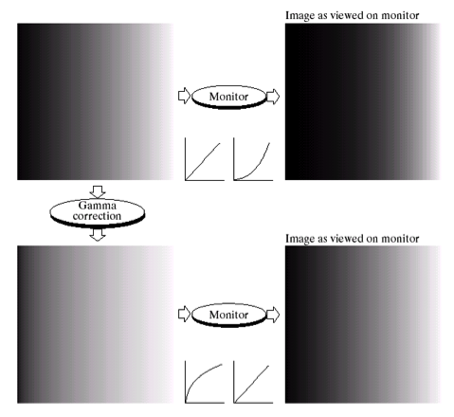
Gamma Correction

Slide 64
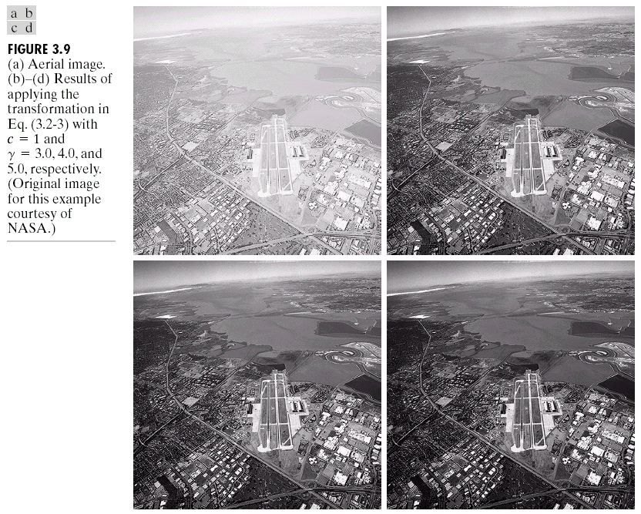

Image Enhancement by PLT
a | b
d | c
Aerial Image
PLT output
images with
(b) γ = 3.0
γ = 4.0 and
γ = 5.0
Input Image (a)
(…Courtesy of NASA)

Slide 65
[6] Intensity Level Slicing
Highlighting a specific range of input values is called Intensity Level Slicing
Case-1 : Without Background
(i) Graphically
(Ii) Mathematically
s
S = L-1 if a < r < b
= 0 Otherwise
(L-1)
0
r
0
a b
(L-1)
65
Kiran TALELE 99870 30 881 talelesir@gmail.com

Slide 66
Case-2 : With Background
(i) Graphically
(ii) Mathematically
s
S = L-1 if a < r < b
= r Otherwise
(L-1)
0
r
0
a b
(L-1)
66
Kiran TALELE 99870 30 881 talelesir@gmail.com

Slide 67
Q7. For the image given below perform the Intensity Level Slicing for a = 2 and b = 5 with background and without background
A =
4 | 2 | 3 | 0
1 | 3 | 5 | 7
5 | 3 | 2 | 1
2 | 4 | 6 | 7
67
Kiran TALELE 99870 30 881 talelesir@gmail.com

Slide 68
Solution :
Case-1 : Without Background
Let S = T ( r )
Where r is the input image pixel value and S is the output image pixel value
S = 7 if 2 < r < 5
i.e. {r = 3, 4}
= 0 Otherwise
Input Image :
Output Image :
F =
4 | 2 | 3 | 0
1 | 3 | 5 | 7
5 | 3 | 2 | 1
2 | 4 | 6 | 7
A =
7 | 0 | 7 | 0
68
68
Kiran TALELE 99870 30 881 talelesir@gmail.com
Kiran TALELE 99870 30 881 talelesir@gmail.com

Slide 69
Solution :
Case-1 : Without Background
Let S = T ( r )
Where r is the input image pixel value and S is the output image pixel value
S = 7 if 2 < r < 5
i.e. {r = 3, 4}
= 0 Otherwise
Input Image :
Output Image :
F =
4 | 2 | 3 | 0
1 | 3 | 5 | 7
5 | 3 | 2 | 1
2 | 4 | 6 | 7
A =
7 | 0 | 7 | 0
0 | 7 | 0 | 0
0 | 7 | 0 | 0
0 | 7 | 0 | 0
69
69
Kiran TALELE 99870 30 881 talelesir@gmail.com
Kiran TALELE 99870 30 881 talelesir@gmail.com

Slide 70
Solution :
Case-2 : With Background
Let S = T ( r )
Where r is the input image pixel value and S is the output image pixel value
S = 7 if 2 < r < 5
i.e. {r = 3, 4}
= r Otherwise
Input Image :
Output Image :
F =
4 | 2 | 3 | 0
1 | 3 | 5 | 7
5 | 3 | 2 | 1
2 | 4 | 6 | 7
A =
7 | 2 | 7 | 0
1 | 7 | 5 | 7
5 | 7 | 2 | 1
2 | 7 | 6 | 7
70
70
Kiran TALELE 99870 30 881 talelesir@gmail.com
Kiran TALELE 99870 30 881 talelesir@gmail.com

Slide 71
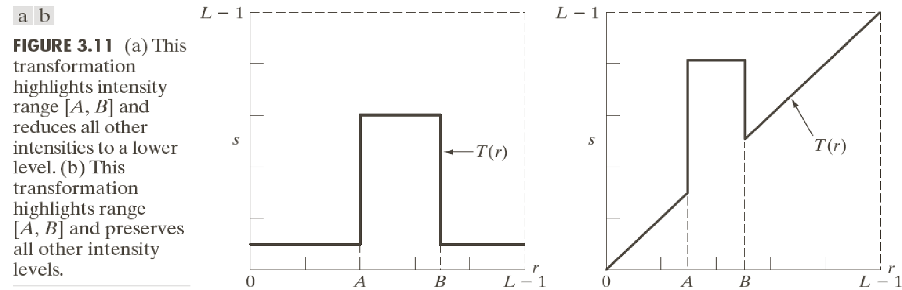
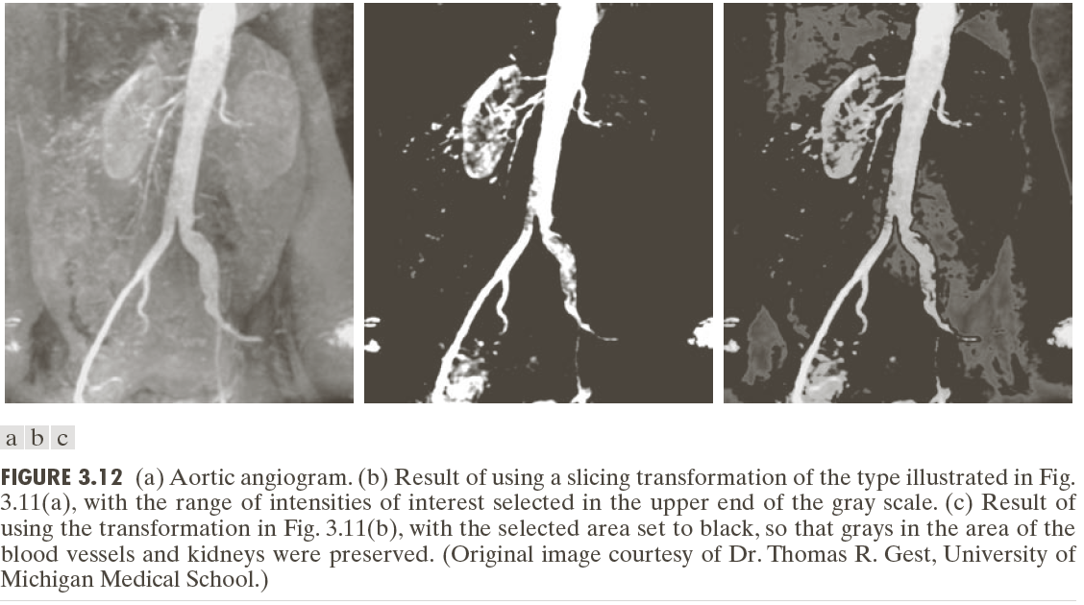
Highlight the major blood vessels and study the shape of the flow of the contrast medium (to detect blockages, etc.)
Measuring the actual flow of the contrast medium as a function of time in a series of images

Slide 72
[7] Bit Level Slicing
Highlighting a specific bit of input pixel values is called Bit Level Slicing.
Mathematically :
For r = [ bn,…b2, b1, b0 ]
If ( bn = 1 )
Then S = L-1
Otherwise S = 0
72
Kiran TALELE 99870 30 881 talelesir@gmail.com

Slide 73
Ex. Consider 3 bit image with r = [b2, b1, b0 ] and L-1 = 7
A =
=
0 | 2 | 4
3 | 6 | 3
5 | 7 | 1
000 | 010 | 100
011 | 110 | 011
101 | 111 | 001
To highlight MSB bit of every pixel :
For r = [ b2, b1, b0 ]
If ( b2 = 1 )
Then S = 7
Otherwise S = 0
B =
0 | 0 | 7
0 | 7 | 0
7 | 7 | 0
73
Kiran TALELE 99870 30 881 talelesir@gmail.com

Slide 74




Dr. Kiran TALELE
Academic : PhD
Professional :
Dean-Students, Alumni & External Relations @ Bharatiya Vidya Bhavans’ Sardar Patel Institute of Technology (SP-IT), Mumbai
Head-Academic Relation @ Sardar Patel Technology Business Incubator (SP-TBI), Mumbai
Treasurer-IEEE Bombay Section
091-9987030881
kiran.talele@spit.ac.in / ktvtalele@gmail.com
https://www.linkedin.com/in/k-t-v-talele/
www.facebook.com/Kiran-Talele-1711929555720263
Stay Connected
74
74

Slide 75
Dr. Kiran TALELE is an Associate Professor in Electronics & Telecommunication Engineering Department of Bharatiya Vidya Bhavans’ Sardar Patel Institute of Technology, Mumbai with 33+ years experience in Academics.
He is a Dean of Students, Alumni and External Relations at Sardar Patel Institute of Technology, Andheri Mumbai.
He is also a Head of Sardar Patel Technology Business Incubator, Mumbai.
His area of research is Digital Signal & Image Processing, Computer Vision, Machine Learning and Multimedia System Design.
He has published 85+ research papers at various national & international refereed conferences and journals. He has filed published 25+ patents at Indian Patent Office. One patent is granted in 2021.
He is a Treasurer of IEEE Bombay Section and Mentor for Startup Incubation & Intellectual Asset Creation.
He is a recipient of P.R. Bapat IEEE Bombay Section Outstanding Volunteer Award 2019.

Slide 76
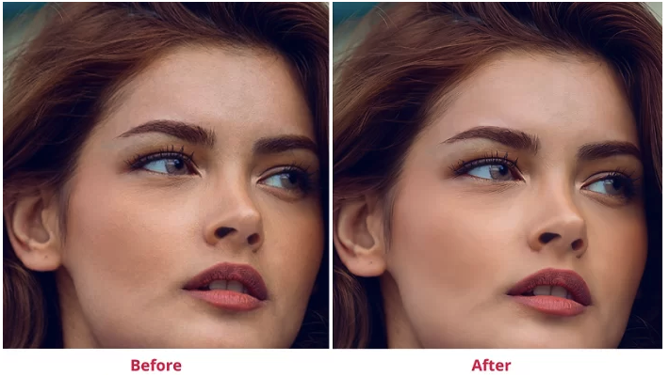
76
Kiran TALELE 99870 30 881 talelesir@gmail.com

Slide 77
